Slide 1

Recap from Day 1
Notes:
TA introduction
Talk about not teaching code (not a programming workshop)

Slide 2







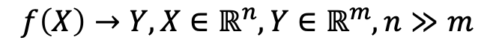
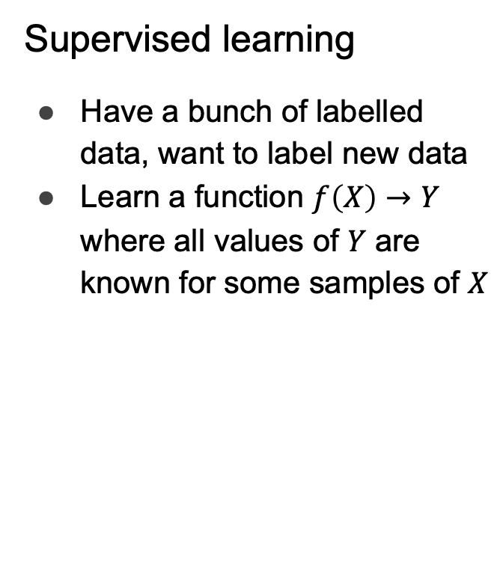
Two kinds of machine learning
Supervised learning
Have a bunch of labelled data, want to label new data
Learn a function $f\left(X\right)→Y$ where all values of $Y$ are known for some samples of $X$
Unsupervised learning
Have a bunch of unlabeled data, want to organize it
Learn an embedding
Lower dimensional, easier to interpret (e.g. as clusters)
$$f\left(X\right)→Y, X∈ℝ^{n}, Y∈ℝ^{m}, n≫m$$
Supervised Learning Model
Unsupervised Learning Model
Noun project
Notes:
Carry the change to the figures

Slide 3
Standard Single-Cell RNA-seq Workflow
Sequencing and read mapping
Quality control and filtering
Normalization
Data Correction
Dimensionality reduction and visualization
Downstream analysis
Clustering
Trajectory inference
Differential expression
Comparison of multiple conditions

Slide 4
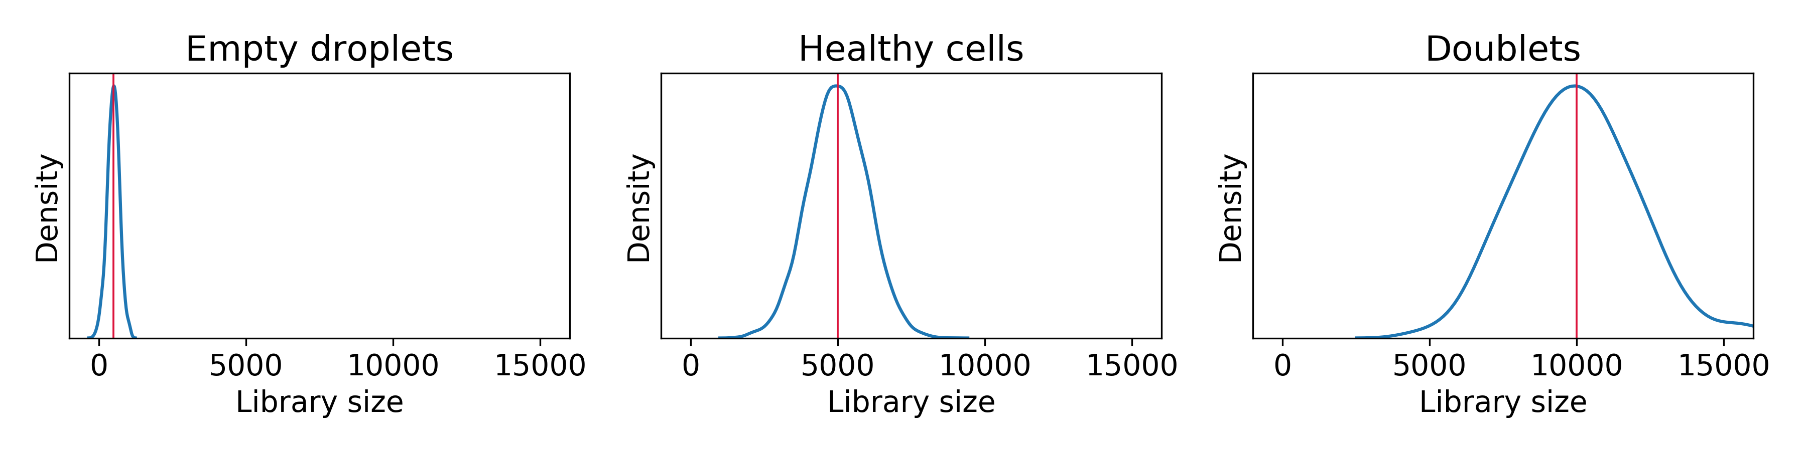
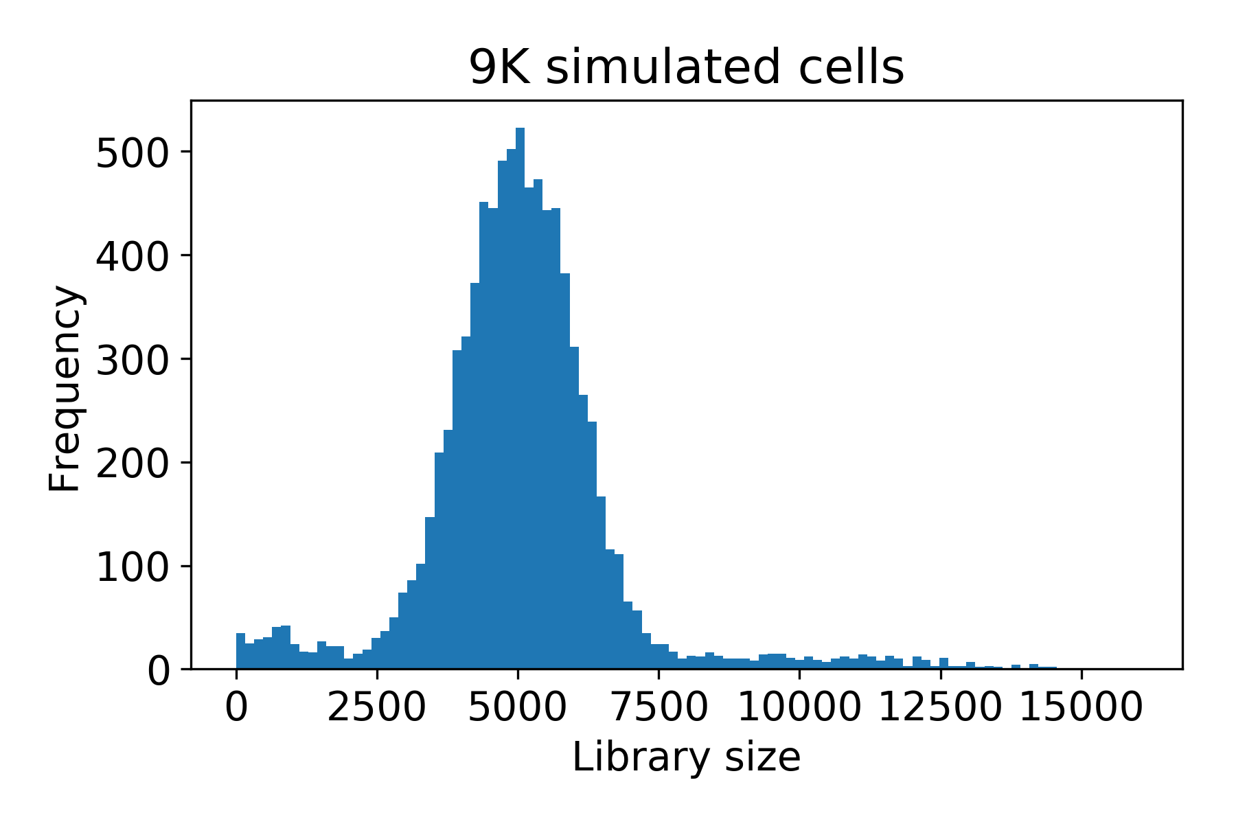

Slide 5
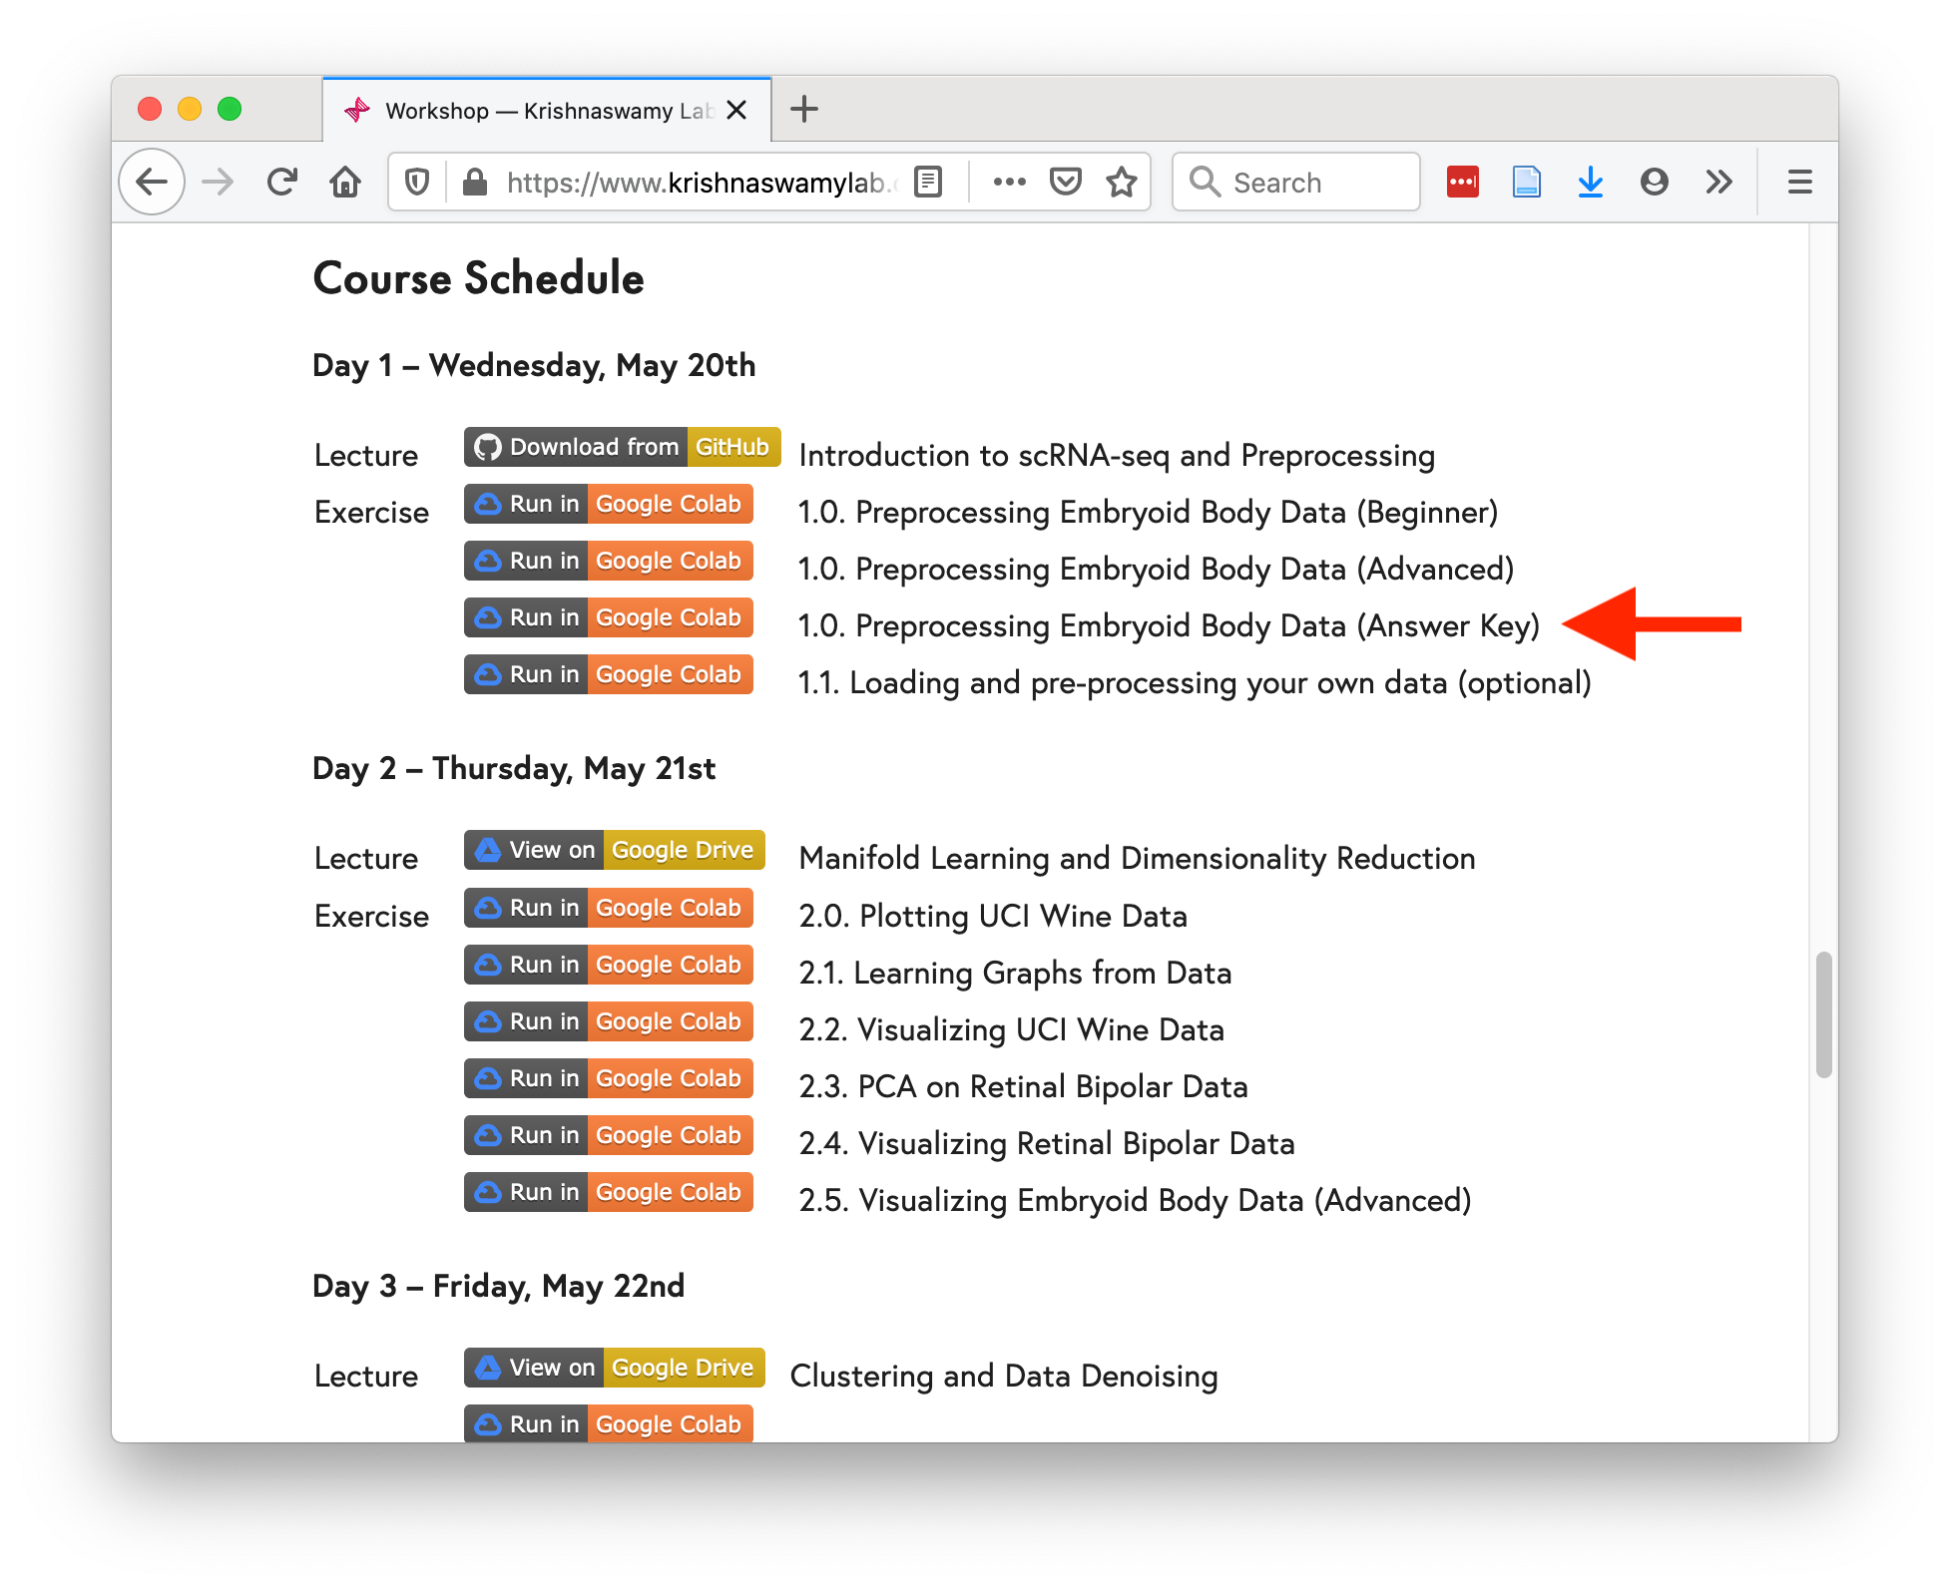
https://www.krishnaswamylab.org/workshop

Slide 6
